Slide 1
7th Annual Lamb Roast Saturday, April 29, 2017 Thorson Hall Lounge

Slide 6
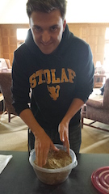

Slide 7
