Slide 1
Classics Conversation Table
Monday, May 7, 2007 Speaker: Prof. Mary McMenomy from Carleton College

Slide 2
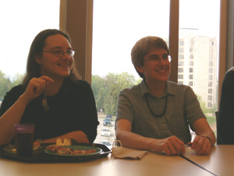

Slide 3
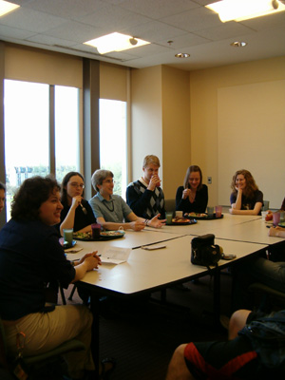

Slide 4
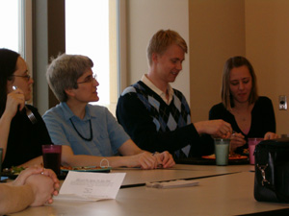

Slide 5
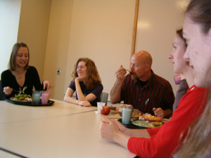

Slide 6
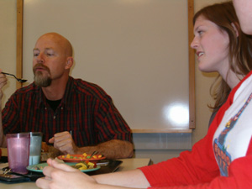

Slide 7
