Slide 1
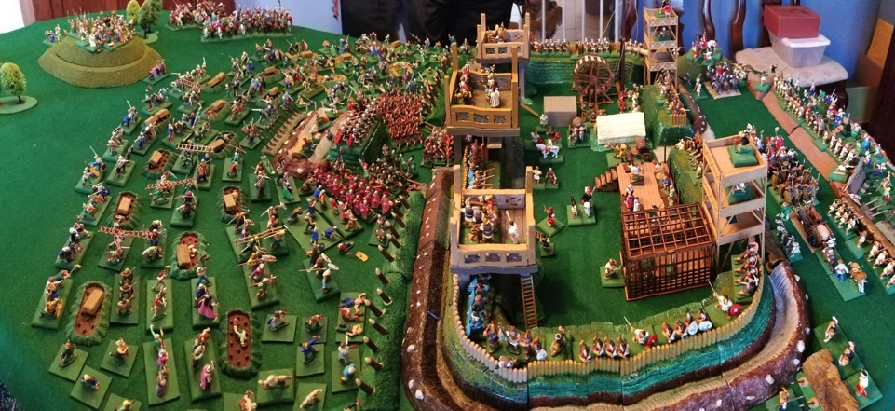
The Battle of Alesia

