Slide 1
Major Declaration Celebration for Sophomores
March 7, 2024
St. Olaf College Ballrooms

Slide 2
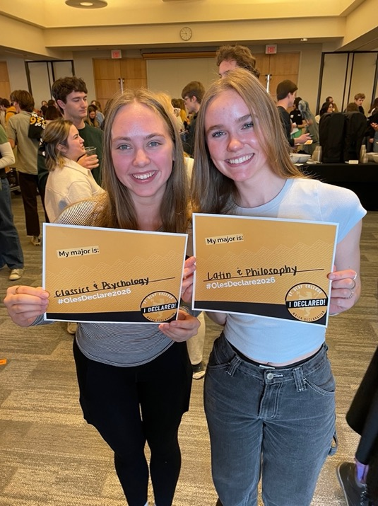
Isabella Baker ’26 and Grace Woog ’26

Slide 3
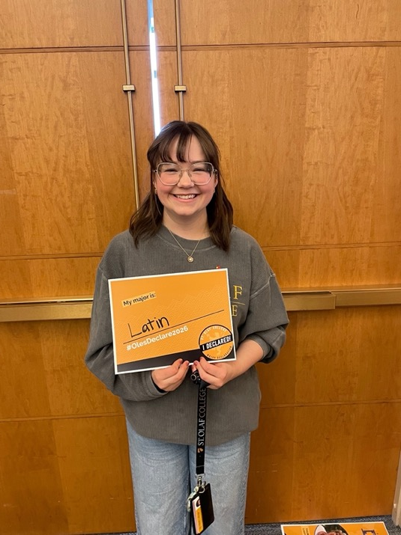
Violet Ecklund-Johnson ’26

Slide 4
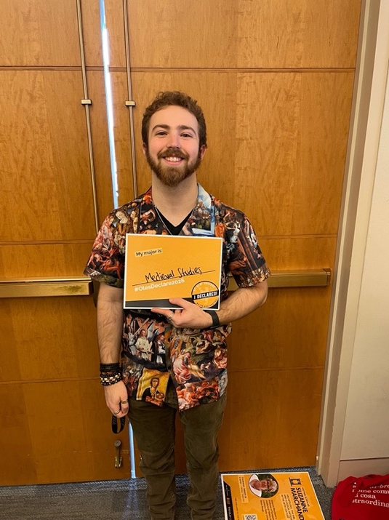
Elliott Ernster ’26

Slide 5
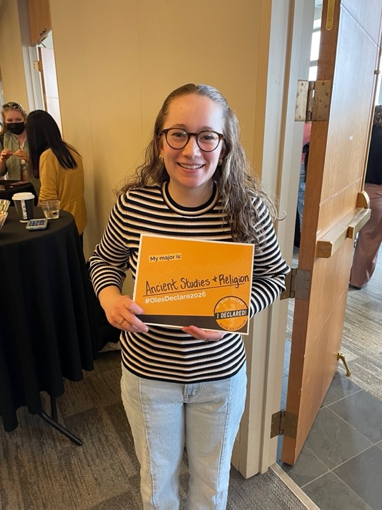
Emery Jansen ’26

Slide 6
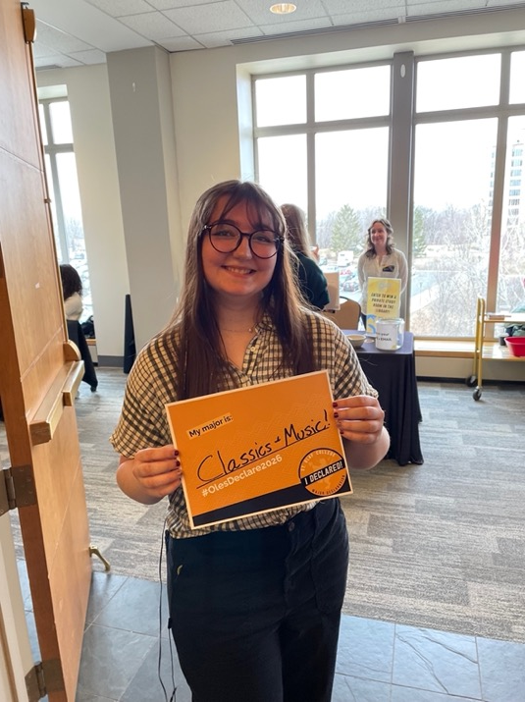
MaKenzie Kuckkan ’26

Slide 7
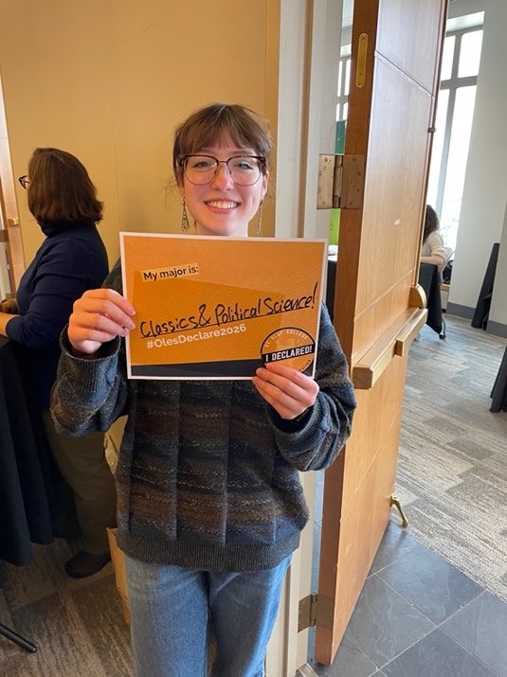
Grace Lindquist ’26

Slide 8
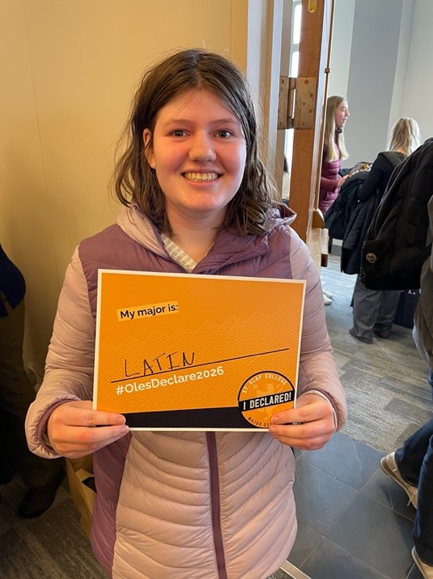
Elsie Olmstead ’26

Slide 9
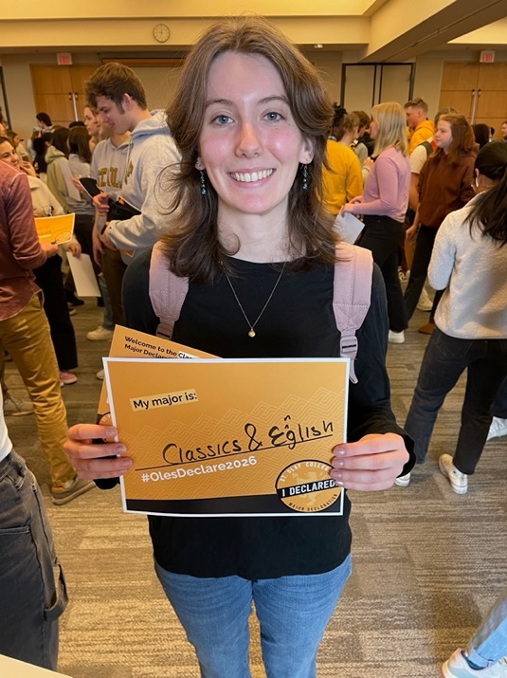
Emma Winkler ’26

